Slide 1
CSCE 121
Linked Lists: Implementation
Dr. Tim McGuire
Some material adapted from Data Abstraction and Problem Solving with Java, by Carrano and Prichard
Notes:
CONCEPT: Dynamically allocated data structures may be linked together in memory to form a chain.

Slide 2
Pointer-Based Linked Lists
A node in a linked list is sometimes defined as a template struct template <typename T>
struct Node {
T item;
Node<T> *next;
};
A node is dynamically allocated
Node<T> *p;
p = new Node<T>;
A node

Slide 3
Node.h
#ifndef NODE_H
#define NODE_H
template <typename T>
struct Node
{
T data; // Node value
Node<T> *next; // Pointer to the next node
Node (T nodeValue) // Constructor
{ data = nodeValue;
next = nullptr;}
};
#endif

Slide 4
Non-template version of Node.h
#ifndef NODE_H
#define NODE_H
struct Node
{
int data; // Node value
Node *next; // Pointer to the next node
Node (int nodeValue) // Constructor
{ data = nodeValue;
next = nullptr;}
};
#endif

Slide 5
Defining a Linked List
Define a pointer for the head of the list:
Node<T> *head = nullptr;
Head pointer initialized to nullptr to indicate an empty list
head
nullptr

Slide 6
NULL Pointer
Is used to indicate end-of-list
Should always be tested for before using a pointer:
Node<T> *p;
while (p != nullptr) ...
Can also test the pointer itself:
while (!p) ... // same meaning
// as above

Slide 7
Linked List Operations

Slide 8
Linked List Operations
Basic operations:
append a node to the end of the list
insert a node within the list
traverse the linked list
delete a node
delete/destroy the list

Slide 9
Create a New Node
newNode
Allocate memory for the new node:
Node<int>* newNode = new Node<int>;
Initialize the contents of the node:
newNode->data = num;
Set the pointer field to the null pointer:
newNode->next = nullptr;
newNode
23
newNode
23
nullptr

Slide 10
Appending a Node
Add a node to the end of the list
Basic process:
Create the new node (as already described)
Add node to the end of the list:
If list is empty, set head pointer to this node
Else,
traverse the list to the end
set pointer of last node to point to new node

Slide 11
Appending a Node (2)
nodePtr
5
13
19
nullptr
list
head
23
nullptr
newNode
New node created, end of list located

Slide 12
Appending a Node (3)
nodePtr
5
13
19
list
head
23
nullptr
newNode
New node added to end of list

Slide 13
NumberList.h (partial)
class NumberList
{
private:
// Declare a structure for the list
struct ListNode
{
double value; // The value in this node
struct ListNode *next; // To point to the next node
};
ListNode *head; // List head pointer
public:
// Constructor
NumberList()
{ head = nullptr; }
// Destructor
~NumberList();
// Linked list operations
void appendNode(double);
…

Slide 14
NumberList::appendNode(double num)
void NumberList::appendNode(double num) {
ListNode *newNode; // To point to a new node
ListNode *nodePtr; // To move through the list
// Allocate a new node and store num there.
newNode = new ListNode;
newNode->value = num;
newNode->next = nullptr;
// If there are no nodes in the list
// make newNode the first node.
if (head == nullptr)
head = newNode;
else { // Otherwise, insert newNode at end.
// Initialize nodePtr to head of list.
nodePtr = head;
// Find the last node in the list.
while (nodePtr->next != nullptr)
nodePtr = nodePtr->next;
// Insert newNode as the last node.
nodePtr->next = newNode;
}
}

Slide 15
Inserting a Node into a Linked List
Used to maintain a linked list in order
Requires two pointers to traverse the list:
pointer to locate the node with data value greater than that of node to be inserted
pointer to 'trail behind' one node, to point to node before point of insertion
New node is inserted between the nodes pointed at by these pointers

Slide 16
Inserting a Node into a Linked List
previousNode
nodePtr
5
13
19
nullptr
list
head
17
nullptr
newNode
New node created, correct position located

Slide 17
Inserting a Node into a Linked List
previousNode
nodePtr
5
13
19
nullptr
list
head
17
newNode
New node inserted in order in the linked list

Slide 18
NumberList::insertNode(double num)
void NumberList::insertNode(double num)
{
ListNode *newNode; // A new node
ListNode *nodePtr; // To traverse the list
ListNode *previousNode = nullptr; // previous node
// Allocate a new node and store num there.
newNode = new ListNode;
newNode->value = num;
// If there are no nodes in the list
// make newNode the first node
if (!head)
{
head = newNode;
newNode->next = nullptr;
}
else // Otherwise, insert newNode
{
// Position nodePtr at the head of list.
nodePtr = head;
// Initialize previousNode to nullptr.
previousNode = nullptr;
// Skip all nodes whose value is
// less than num.
while (nodePtr !=nullptr && nodePtr->value <num)
{
previousNode = nodePtr;
nodePtr = nodePtr->next;
}
// If new node is to be the 1st in the list,
// insert it before all other nodes.
if (previousNode == nullptr)
{
head = newNode;
newNode->next = nodePtr;
}
else // insert after the previous node.
{
previousNode->next = newNode;
newNode->next = nodePtr;
}
}
}

Slide 19
Traversing a Linked List
Visit each node in a linked list: display contents, validate data, etc.
Basic process:
set a pointer to the contents of the head pointer
while pointer is not nullptr
process data
go to the next node by setting the pointer to the pointer field of the current node in the list
end while

Slide 20
Traversing a Linked List
nodePtr
5
13
19
nullptr
list
head
nodePtr points to the node containing 5, then the node containing 13, then the node containing 19, then points to nullptr, and the list traversal stops

Slide 21
NumberList::displayList()
void NumberList::displayList() const
{
ListNode *nodePtr; // To move through the list
// Position nodePtr at the head of the list.
nodePtr = head;
// While nodePtr points to a node, traverse the list.
while (nodePtr)
{
// Display the value in this node.
cout << nodePtr->value << endl;
// Move to the next node.
nodePtr = nodePtr->next;
}
}

Slide 22
Deleting a Node
Used to remove a node from a linked list
If list uses dynamic memory, then delete node from memory
Requires two pointers: one to locate the node to be deleted, one to point to the node before the node to be deleted
Notes:
Deleting a node from a linked list requires two steps:
1. Remove the node from the list without breaking the links created by the next pointers.
2. Delete the node from memory.
This Requires two pointers: one to locate the node to be deleted, one to point to the node before the node to be deleted

Slide 23
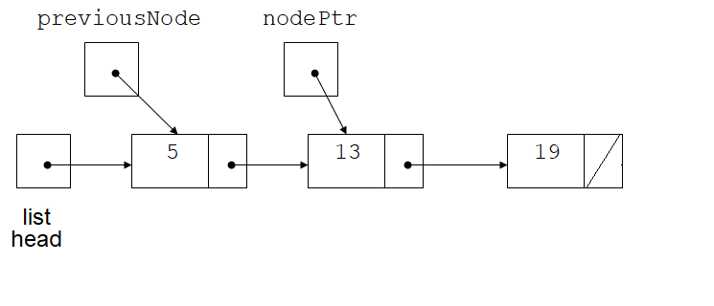
Deleting a Node (2)
headPtr
Locating the node containing 13
Notes:
Suppose we want to delete the node which contains 13.
We have to know what node comes before it in the linked list.
Call that node, “previousNode”.

Slide 24
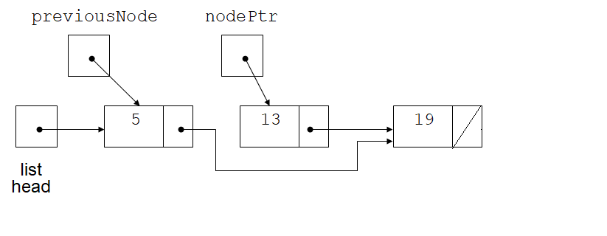
Deleting a Node (3)
headPtr
Adjusting pointer around the node to be deleted
Notes:
We have to make the next field of previousNode point to the node that comes after the node we want to delete.
We do that by copying the pointer out of the next field of the node we are going to delete.

Slide 25
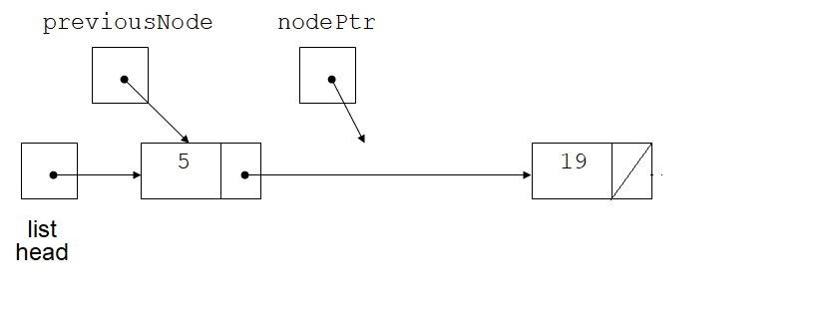
Deleting a Node (4)
headPtr
Linked list after deleting the node containing 13
Notes:
We delete the node.
But the nodePtr is still pointing to the deleted node.

Slide 26
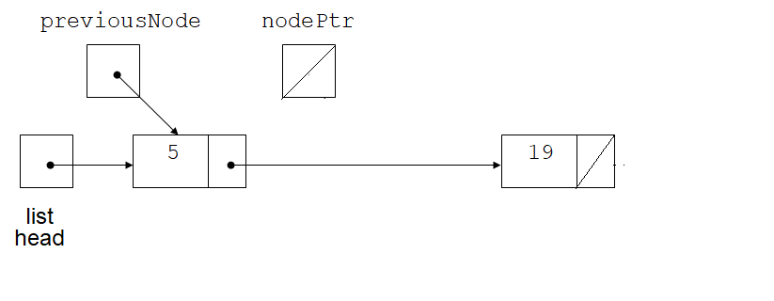
Deleting a Node (5)
headPtr
Linked list after deleting the node containing 13
Notes:
So we also need to set nodePtr to the null pointer to complete the operation

Slide 27
NumberList::deleteNode(double num)
void NumberList::deleteNode(double num)
{
ListNode *nodePtr; // To traverse the list
ListNode *previousNode; // To point to the
// previous node
// If the list is empty, do nothing.
if (!head)
return;
// Determine if the first node is the one.
if (head->value == num)
{
nodePtr = head->next;
delete head;
head = nodePtr;
}
else
{
// Initialize nodePtr to head of list
nodePtr = head;
// Skip all nodes whose value member is
// not equal to num.
while (nodePtr != nullptr && nodePtr->value != num)
{
previousNode = nodePtr;
nodePtr = nodePtr->next;
}
// If nodePtr is not at the end of the
// list, link the prev. node to the node
// after nodePtr, then delete nodePtr.
if (nodePtr)
{
previousNode->next = nodePtr->next;
delete nodePtr;
nodePtr = nullptr;
}
}
}

Slide 28
Destroying a Linked List
Must remove all nodes used in the list
To do this, use list traversal to visit each node
For each node,
Unlink the node from the list
If the list uses dynamic memory, then free the node’s memory
Set the list head to nullptr

Slide 29
NumberList::~NumberList()
NumberList::~NumberList() {
ListNode *nodePtr; // To traverse the list
ListNode *nextNode; // To point to the next node
// Position nodePtr at the head of the list.
nodePtr = head;
// While nodePtr is not at the end of the list...
while (nodePtr != nullptr) {
// Save a pointer to the next node.
nextNode = nodePtr->next;
// Delete the current node.
delete nodePtr;
// Position nodePtr at the next node.
nodePtr = nextNode;
}
}

Slide 30
See NumberList.h, NumberList.cpp, and ListDriver3.cpp for a complete implementation

Slide 31
Variations of the Linked List
Notes:
There are many ways to link dynamically allocated data structures together.
Two variations of the linked list are the doubly linked list and the circular linked list.

Slide 32
Variations of the Linked List (1)
Other linked list organizations:
doubly-linked list: each node contains two pointers: one to the next node in the list, one to the previous node in the list
5
13
19
nullptr
list
head
headPtr
nullptr
Notes:
In the doubly-linked list, each node contains two pointers: one to the next node in the list, one to the previous node in the list
Note that this makes it possible to move both forward and backward in the linked list.
.

Slide 33
Variations of the Linked List (2)
Other linked list organizations:
circular linked list: the last node in the list points back to the first node in the list, not to nullptr
Note that the head can move
5
13
19
list
head
Notes:
In the circular list, instead of the last node containing the null pointer, it contains a pointer back to the first node in the list
Note that the head can move, so we typically call it the list pointer instead of the head pointer.

Slide 34
See LinkedListTemplated directory for an example

Slide 35
The STL list Container

Slide 36
The STL list Container
Template for a doubly linked list
Member functions for
locating beginning, end of list: front, back, end
adding elements to the list: insert, merge, push_back, push_front
removing elements from the list: erase, pop_back, pop_front, unique

